Slide 1
Cyclistic Bike-Share: Data-Driven Conversion Strategy Understanding User Behavior to Drive High-Margin Membership Growth
Presented by: Pritesh Das (Junior Data Analyst, Marketing Analytics Team, Cyclistic)

Slide 2
🎯 The Mission & Business Task
Shifting Focus from Broad Awareness to High-Margin Conversion:
The Executive Mandate: The Director of Marketing, Lily Moreno, has identified that Cyclistic's future success depends entirely on maximizing the number of annual memberships.
The Strategic Shift: Moving away from broad brand awareness campaigns to target casual riders (single/full-day pass holders) who are already familiar with our service and represent a high-potential segment for growth.
The Core Analytical Question: "How do annual members and casual riders use Cyclistic bikes differently?“
The Goal: Deliver compelling, data-backed insights and visualizations to design a marketing playbook approved by the executive team.

Slide 3
⚙️ Data Pipeline & Technical Rigor
Building an Airtight Foundation for Strategic Decisions:
Data Scale: Analyzed a massive public dataset encompassing a full calendar year of historical trip logs (January 2024 to December 2024).
Advanced Processing: Utilized SQL Server Management Studio (SSMS 22) to check schema consistency and execute UNION ALL consolidation across 12 monthly transaction files.
Data Cleansing & Integrity: Systematically isolated and removed 1,496,735 rows containing null or missing values and Engineered new time-delta features: avg_ride_length_in_seconds, day_of_week, and month.
Anomalous Outlier Filtration: Excluded trips under 1 minute (false starts/docking adjustments) and over 24 hours (lost/unreturned equipment) to eliminate metric skew.
Final Verified Audited Dataset: 4,224,062 clean rows optimized for analytics.

Slide 4
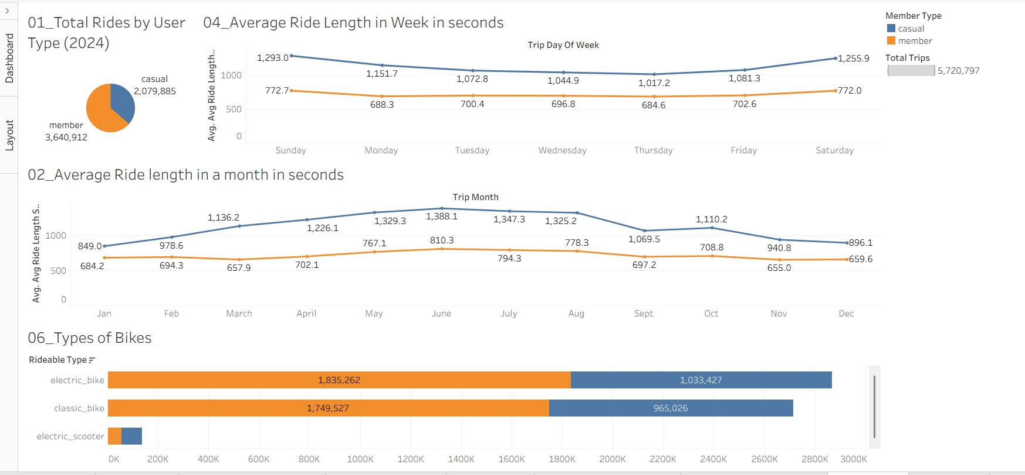
1st Dashboard

Slide 5
Key Insights — Volume, Duration, and Fleet Preferences (1st Dashboard)
Total Rides and Market Share
Annual members drive the core volume, completing 3,640,912 trips, which accounts for 63.64% of total ridership.
Casual riders account for a strong secondary market share of 36.36%, executing 2,079,885 trips.
Weekly Ride Duration Trends
Casual riders consistently cycle for longer durations than members every single day of the week.
Casual trip duration peaks sharply on Sundays at 1,293 seconds (21.55 minutes) and Saturdays at 1,255.9 seconds (20.93 minutes).
Member trip duration remains incredibly flat and steady, peaking slightly on Sundays at 772.7 seconds (12.87 minutes) and Saturdays at 772 seconds (12.86 minutes).
Monthly Duration and Seasonality
Both user segments experience their longest individual trip lengths in June, with casual riders reaching an average maximum of 1,388.1 seconds (23.13 minutes) and members peaking at 810.3 seconds (13.50 minutes).
Trip lengths for both groups decline significantly during winter, bottoming out around November and December.
Fleet and Asset Preferences
Both customer cohorts show a clear preference for electric bicycles over classic, traditional models.
For electric bikes, annual members logged 1,835,262 trips while casual riders completed 1,033,427 trips.
For classic bikes, annual members logged 1,749,527 trips compared to 965,026 trips by casual riders.
Electric scooters represent a notable micromobility niche, where casual riders out-utilize members.

Slide 6
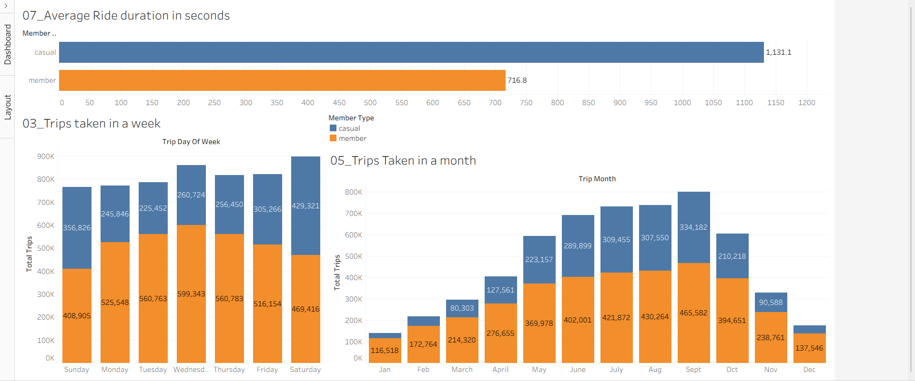
2nd Dashboard

Slide 7
Key Insights — Ride Duration, Weekly Volume, and Monthly Trends (2nd Dashboard)
Overall Average Ride Duration
Casual riders display significantly higher individual asset engagement, averaging 1,131.1 seconds (~18.85 mins) per trip.
Annual member rides average 716.8 seconds (~11.94 mins), indicating a point-to-point utility commute pattern.
Weekly Ridership Volume
Annual members provide consistent, high-volume fleet activity throughout the standard workweek, peaking sharply on Wednesdays with 599,343 rides.
Member activity drops to its lowest weekly level on Sundays with 408,905 rides.
Casual riders show a distinct preference for weekend usage, surging to their highest weekly volume on Saturdays with 429,321 rides.
Casual activity drops to its lowest weekly point on Tuesdays with 225,452 rides.
Monthly Volumetric Trends
Both customer segments experience their lowest service utilization in January, with annual members at 116,518 rides and casual riders at 23,642 rides.
Ridership increases steadily during the warmer spring and summer months for both groups.
Casual riders reach their absolute highest peak of the year in September with 334,182 rides.
Annual members maximize their total monthly volume in July with 465,582 rides.

Slide 8
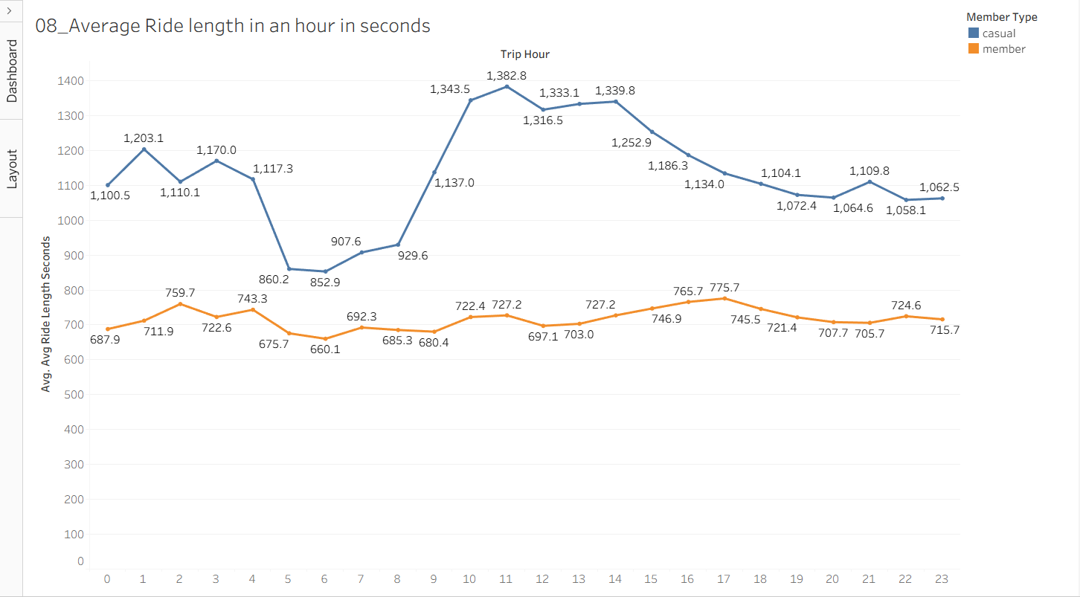
3rd Dashboard

Slide 9
Key Insights — Hourly Ride Length Dynamics
Casual User Hourly Behavior
Casual riders maintain a significantly higher average trip duration than members across every single hour of the day.
Casual riders record their absolute longest average rides during the midday window, peaking at 11:00 AM with an average of 1,382.8 seconds (~23.05 minutes).
A secondary high-duration plateau is sustained for casual riders throughout the afternoon, remaining above 1,300 seconds from 10:00 AM through 2:00 PM (14:00).
The shortest average trips for casual riders occur in the early morning, hitting a low of 852.9 seconds (~14.22 minutes) at 6:00 AM.
Annual Member Hourly Behavior
Annual members exhibit a highly stable and flat trip duration baseline, remaining between 660 and 780 seconds throughout the entire 24-hour cycle.
Members reach their maximum average trip duration during the evening commute window, peaking at 5:00 PM (17:00) with 775.7 seconds (~12.93 minutes).
Similar to casual riders, members record their shortest average trip durations in the early morning, hitting a floor of 660.1 seconds (11.00 minutes) at 6:00 AM.
Comparative Takeaways
At 11:00 AM, the casual ride duration gap reaches its widest margin, where casual trips are nearly double the length of member trips (1,382.8 seconds vs. 727.2 seconds).
The synchronized 6:00 AM drop for both segments suggests that early morning riders—regardless of membership status—primarily prioritize fast, direct, and efficient point-to-point travel.

Slide 10
🚀 Strategic Playbook Part 1 — Product & Packaging
Meeting Casual Riders Where Their Habits Are:
1. The "Summer Explorer" Tier (Membership Personalization)
The Insight: Casual use spikes dramatically in summer for long, continuous durations.
The Strategy: Introduce custom, short-term programmatic subscriptions (monthly passes or seasonal packages) to bridge the financial gap for riders who aren't ready for a 12-month commitment but demand summer volume.
2. Electric Fleet Incentives
The Insight: Casual users show an outsized preference for electric bikes and scooters.
The Strategy: Introduce member-exclusive benefits for electric fleet options, such as priority app unlocking, free advanced reservations, or lowered per-minute rates, converting asset affinity into membership sign-ups.

Slide 11
🚀 Strategic Playbook Part 2 — Engagement & Marketing
Data-Timed Digital Outreach & Social Value
3. The "Weekend Warrior" Loyalty Infrastructure
The Insight: Casual riders hit maximum volume on Saturdays and Sundays.
The Strategy: Launch a points-based loyalty program where frequent weekend single-pass and full-day riders automatically accumulate points that can be converted directly into a currency discount toward purchasing a standard annual subscription.
4. Hyper-Targeted Digital Campaigns
The Insight: Casual users peak heavily on summer weekends around 11:00 AM.
The Strategy: Trigger geotargeted digital ads on social media platforms precisely during peak casual windows (Weekends at 11:00 AM, May–September), utilizing user-generated content emphasizing premium lifestyle and recreation.
5. Member-Exclusive Experiential Events
The Strategy: Organize exclusive summer community group rides, neighborhood navigation challenges, and urban exploration events to build a strong community aspect around owning a Cyclistic membership.

Slide 12
Conclusion: The Bottom Line
Transforming Leisure into High-Margin Retained Revenue
1. The Core Contrast Uncovered:
Annual Members: Utilize Cyclistic as an essential point-to-point utility for occupational commuting.
Casual Riders: Leverage the system as a premium leisure and experiential asset.
2. Strategic ROI: Transitioning from broad, generic brand awareness to precise behavioral conversion unlocks a predictable, compounding revenue stream.
3. The Next Step: Implementing these tailored digital strategies, loyalty hooks, and customized packages will successfully convert casual riders into high-margin annual members, ensuring the long-term profitability and sustainable growth of Cyclistic.

Slide 13


